Slide 1
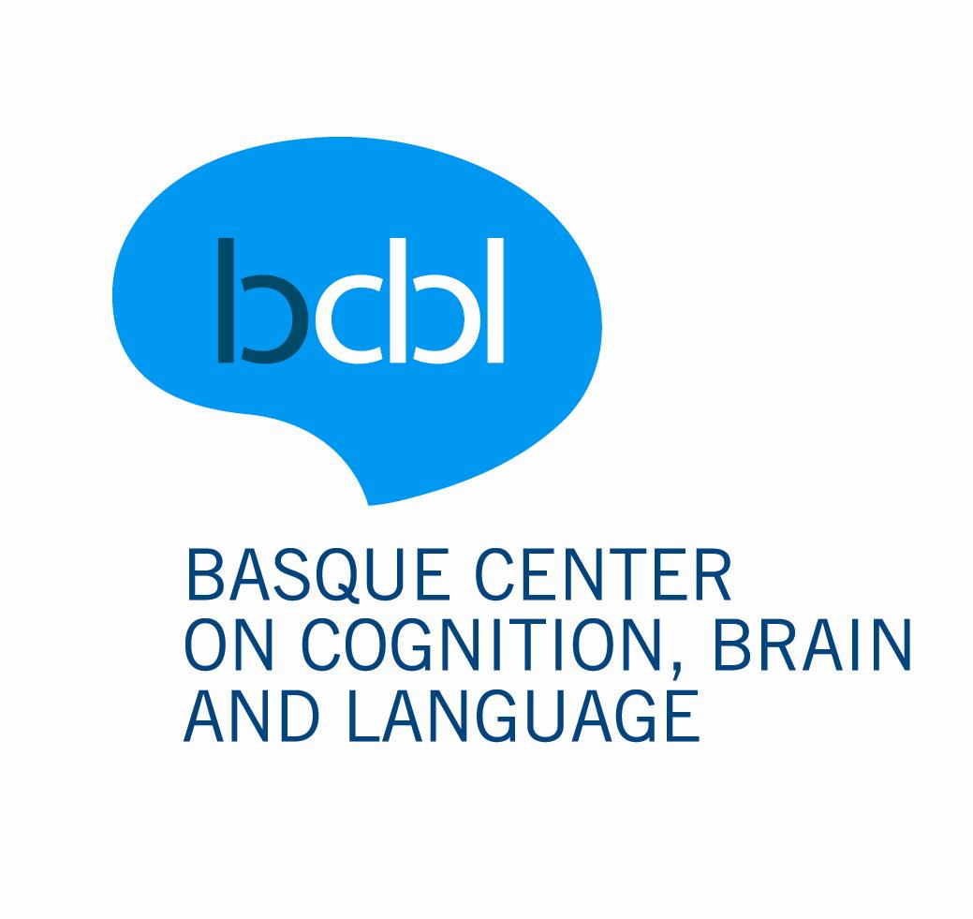


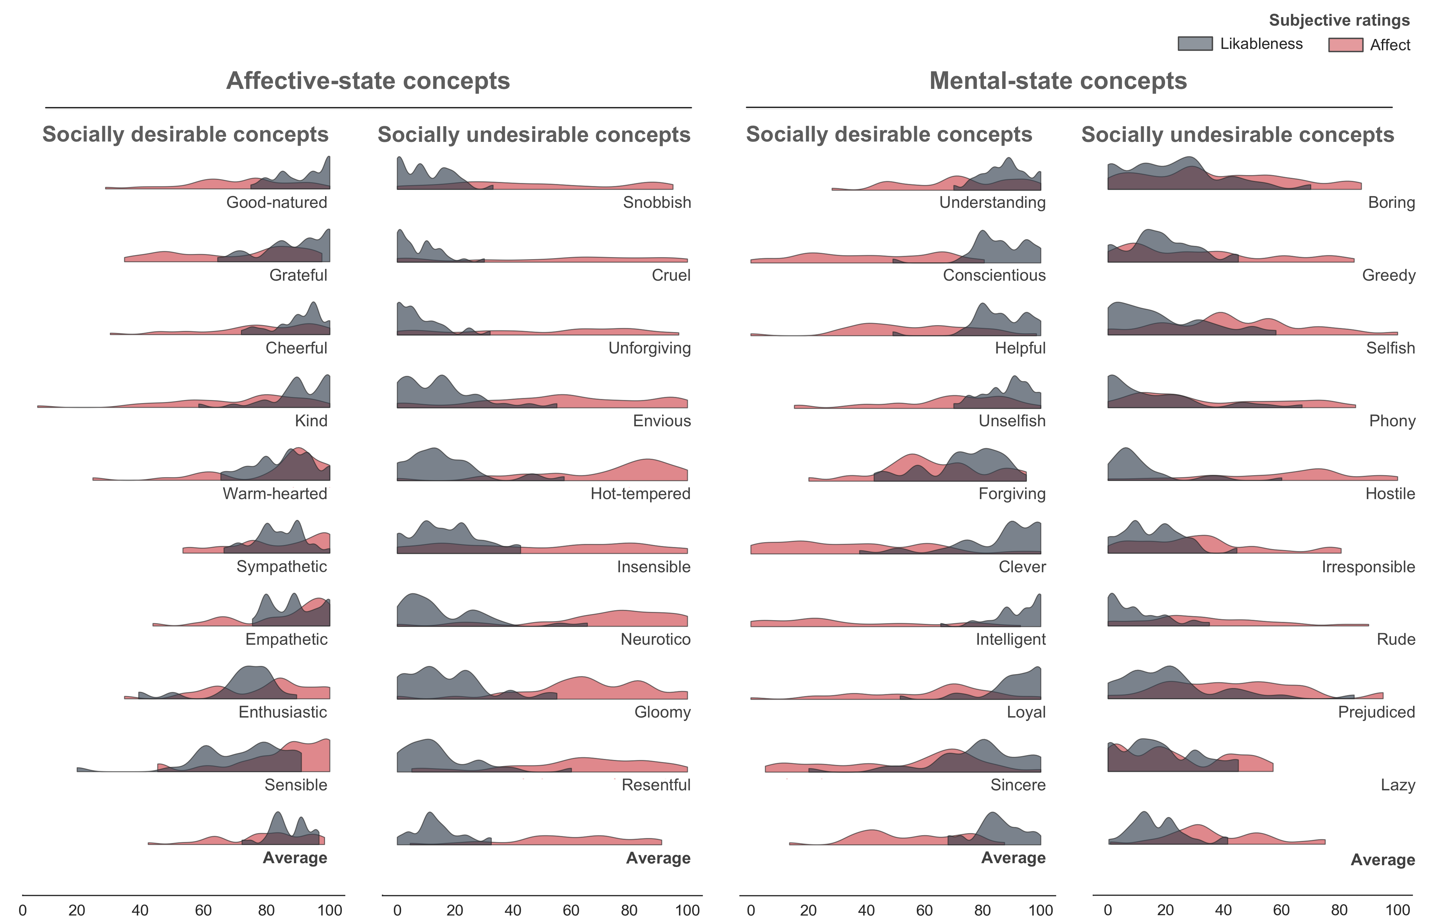
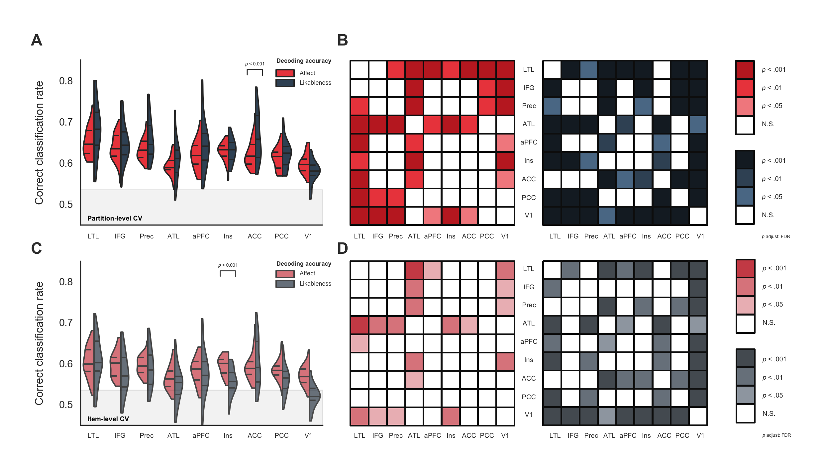
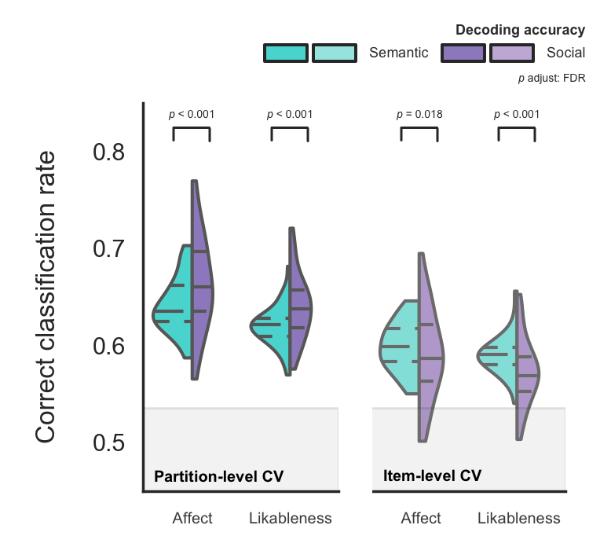
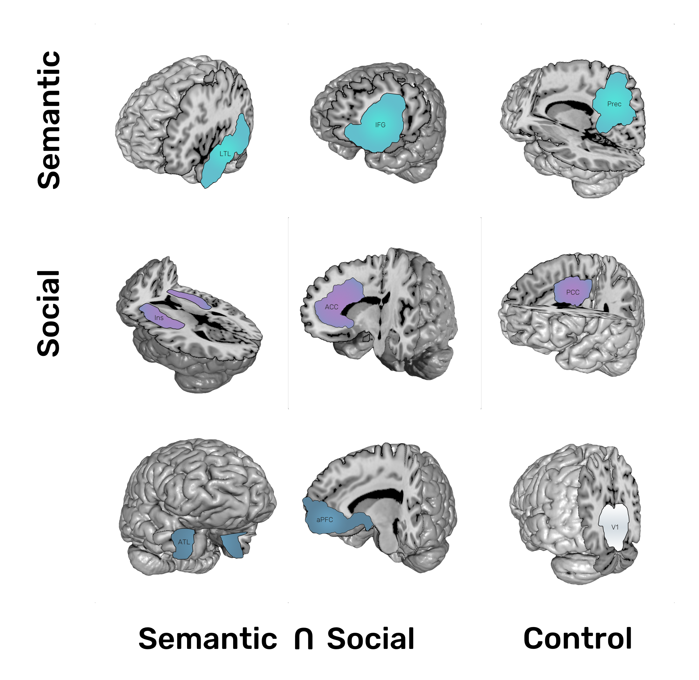
Decoding social knowledge in the human brain
Daniel Alcalá-López¹, David Soto^{1,2}
d.alcala@bcbl.eu
¹Basque Center on Cognition, Brain and Language (BCBL), Donostia – San Sebastian, Spain
²Ikerbasque, Basque Foundation for Science, Bilbao, Spain
@danalclop
Motivation
Decoding the brain representation of social concepts
How does the brain represent conceptual meaning about the attitudes, beliefs, or emotions of other people?
1
The intraclass correlation coefficient shows a fair test-retest repeatability for the ratings of affect and excellent for the ratings of likableness.
We have extensive evidence that we can use BOLD activity to classify conceptual knowledge using a variety of concrete concepts (e.g. animals or tools; JV Haxby 2012 Neuroimage).
ID | Concept | Pre | Post | Dimension
sub-001 | Boring | 20 | 10 | likableness
sub-001 | Good-natured | 65 | 70 | likableness
sub-001 | Thankful | 81 | 72 | likableness
sub-001 | Cheerful | 95 | 80 | likableness
… | … | … | …
sub-030 | Resentful | 50 | 70 | affect
sub-030 | Sensible | 100 | 95 | affect
sub-030 | Honest | 50 | 50 | affect
sub-030 | Lazy | 10 | 0 | affect
Only recently there has been a similar interest in studying the brain representations of abstract concepts (M Ghio et al. 2016 Neuroimage; Y Wang et al. 2017 PNAS).
Abstract conceptual knowledge about others likely involves a range of underlying dimensions, yet it is unknown whether (and how) the brain maps different aspects of social information. We investigated the brain representations of social knowledge associated with two fundamental processes in social cognition: affect and likableness (NH Anderson 1968 J Pers Soc Psychol).
ICC_{affect} = 0’47 [0,36-0,60]
This fMRI study investigated the representation of abstract social concepts in the human brain using multivariate pattern analysis (MVPA).
ICC_{likableness} = 0’93 [0,89-0,96]
2
Ratings of affect (red) of concepts related to affective states were significantly higher than those related to non-affective mental states (t₍₂₉₎ = 8.026, p < 0.001, d = 1.465) and ratings of likableness (grey) of socially desirable concepts were significantly higher than those of socially undesirable concepts
(t₍₂₉₎ = 30.382, p < 0.001, d = 5.547; see Fig. 1)
Methods
We asked participants (n = 30; mean age 24.07 ± 3.67 years; 18 females) to rate on a scale from 0 to 100 how likable and affective was each social concept before and after the scanning session.
Figure 1. Distribution of ratings of social concepts. Participants read each concept definition and rated whether the described behavior involved the emotions of oneself or others (affect; red) as well as whether such behavior was socially desirable (likableness; grey) on a scale from 0 (very nonaffective; very unlikable) to 100 (very affective; very likable).
During the fMRI session participants listened to short definitions of social concepts and then mentally simulated another individual behaving the way it was described in the definition:
3
Subjective ratings suggest that the likableness of others’ behavior can weigh more heavily on how we represent social knowledge than affect.
4
A set of repeated-measures ANOVAs with one factor (ROI) showed significant differences in decoding accuracy among ROIs for each classification problem.
 | Sum of Squares | df | Mean Square | F | p | ω²
Affect (partitionCV) | 0.086 | 8 | 0.011 | 19.505 | < .001 | 0.244
Affect (itemCV) | 0.040 | 8 | 0.005 | 8.195 | < .001 | 0.240
Likableness (partitionCV) | 0.240 | 8 | 0.030 | 30.888 | < .001 | 0.267
Likableness(itemCV) | 0.176 | 8 | 0.038 | 23.531 | < .001 | 0.218
*
fixation
delay
“She can reason, solve problems
and understand complex ideas”
250 ms
500 ms
definition
think
3 s
3 s
*
jitter
8 s
A scanning session was composed of 8 functional runs and a structural run halfway through the session.
Each functional run contained 36 trials
(one trial per social concept; 9 concepts for each concept class). A trial consisted on the auditory presentation of the definition of the social concept for 3.5 seconds followed by another short period of 3.5 seconds to mentally simulate the referred behavior.
fMRI data was preprocessed as follows: (i) removal of non-brain tissue using FSL’s BET; (ii) volume realignment using MCFLIRT; (iii) gaussian kernel (FWHM = 3mm) for spatial smoothing; (iv) ICA-based automatic removal of motion artefacts; (v) temporal filtering (high-pass; cutoff = 60s); (vi) coalignment of each session to a reference volume (1st session).
After stacking, detrending, and z-scoring each ROI’s BOLD data we used an SVM-based linear classifier to decode the brain representation of social concepts regarding: (i) their likableness (high vs. low) and (ii) their affect (high vs. low). We used a PCA-based feature selection within each ROI and leave-one-out cross-validation (300 permutations).
For the cross-validation (CV) procedure, we first used partitions of the stacked BOLD data as left-out samples to test the classifier. As a robustness check, we also performed another CV using entire items (i.e. concepts) as left-out sample for testing to better ensure out-of-sample generalization.
Figure 2. Decoding accuracies of social concepts across the brain. Classification accuracy of both the affect and likableness of social knowledge using partition-level (A) as well as item-level (C) cross-validation procedures. Panels (B) and (D) show post hoc paired t-tests of separate repeated-measures ANOVAs with one factor (ROI) for affect (red) and likableness (grey) for both CV procedures.
5
A repeated-measures ANOVA with two factors:
ROI and dimension of social information (i.e. affect vs. likableness) showed a significant main effect of dimension for both the cross-validation procedures (see Fig. 2).
 |  | Sum of Squares | df | Mean Square | F | p | ω²
Partition CV | ROI | 0.289 | 8 | 0.036 | 39.395 | < .001 | 0.314
 | Dimension | 0.034 | 1 | 0.034 | 7.801 | 0.009 | 0.054
 | ROI * Dimension | 0.037 | 8 | 0.005 | 7.640 | < .001 | 0.056
Item CV | ROI | 0.171 | 8 | 0.033 | 27.657 | < .001 | 0.334
 | Dimension | 0.033 | 1 | 0.033 | 2.938 | 0.097 | 0.043
 | ROI * Dimension | 0.045 | 8 | 0.009 | 7.281 | < .001 | 0.105
To obtain an empirical estimate of chance level performance, we trained a classifier on examples with randomly shuffled labels and then tested on the examples labelled appropriately. Statistical significance of above-chance decoding accuracy was then tested using paired t-tests corrected for the number of ROIs.
Statistical significance of decoding performance at the group level was assessed with two repeated-measures ANOVAs with one factor (ROI) to analyze differences between ROIs. Then, to further explore whether our ROIs showed a bias towards decoding more the affect or likableness of social knowledge, we performed a repeated-measures ANOVA with two factors: ROI and dimension of social information (i.e. affect vs. likableness). Finally, we used paired t-tests to compare the average decoding accuracy in semantic ROIs compared with social ROIs
6
Post hoc paired t-tests showed that the interaction effect was driven by the ACC (t₍₂₉₎ = 4.461, p = 0.001,
d = 0.814), which showed a preference for the likableness dimension when using the partition-level CV. On the other hand, the interaction effect was driven by the Ins (t₍₂₉₎ = -4.623, p = 0.001, d = 0.844), which showed a preference for the affect dimension instead when using the item-level CV.
7
Finally, we compared whether social knowledge was differentially represented in ROIs selected as canonical semantic regions (i.e. the LTL, IFG, and Prec) to ROIs selected as social information processing regions (i.e. the Ins, ACC, and PCC; see Fig. 3). Paired t-tests showed that mean classification accuracy was significantly higher in semantic ROIs for both affect (t₍₂₉₎ = 5.590, p < .001, d = 1.021) and likableness (t₍₂₉₎ = 5.113, p < .001, d = 0.933) using partition-level cross-validation. Similarly, mean decoding accuracy was higher in semantic ROIs for both affect (t₍₂₉₎ = 2.519, p = 0.018, d = 0.460) and likableness (t₍₂₉₎ = 4.133, p < .001, d = 0.755) using item-level cross-validation.
Figure 3. Decoding accuracy of social concepts in semantic vs. social ROIs. Classification accuracy in semantic ROIs was significantly higher than in social ROIs using both partition- and item-level cross-validation procedures. The shaded area indicates the mean empirically estimated chance level (mean = 0.53).
We focused on a set of regions of interest (ROIs) based on previous studies on semantic (JR Binder et al. 2009 Cereb Cortex) and social information processing (D Alcalá-López et al. 2017 Cereb Cortex):
+ 3 semantic regions (lateral temporal
lobe, LTL; inferior frontal gyrus, IFG;
and precuneus, Prec)
Take-home messages
Alcalá-López, D., Smallwood, J., Jefferies, E., Van Overwalle, F., Vogeley, K., Mars, R. B., ... & Bzdok, D. (2017). Computing the social brain connectome across systems and states. Cerebral cortex, 28(7), 2207-2232.
Anderson, N. H. (1968). Likableness ratings of 555 personality-trait words. Journal of personality and social psychology, 9(3), 272.
Binder, J. R., Desai, R. H., Graves, W. W., & Conant, L. L. (2009). Where is the semantic system? A critical review and meta-analysis of 120 functional neuroimaging studies. Cerebral Cortex, 19(12), 2767-2796.
Haxby, J. V. (2012). Multivariate pattern analysis of fMRI: the early beginnings. Neuroimage, 62(2), 852-855.
Ghio, M., Vaghi, M. M. S., Perani, D., & Tettamanti, M. (2016). Decoding the neural representation of fine-grained conceptual categories. Neuroimage, 132, 93-103.
Wang, Y., Collins, J. A., Koski, J., Nugiel, T., Metoki, A., & Olson, I. R. (2017). Dynamic neural architecture for social knowledge retrieval. Proceedings of the National Academy of Sciences, 114(16), E3305-E3314.
+ 3 social regions (insula, Ins;
anterior cingulate cortex, ACC;
posterior cingulate cortex, PCC)
LTL
IFG
Prec
Putative semantic regions, such as the lateral temporal lobe, inferior frontal gyrus, and precuneus, outperformed on average canonical social ROIs including the insula, anterior cingulate, and anterior prefrontal cortex.
+ 2 semantic & social regions
(anterior temporal lobe, ATL;
anterior prefrontal cortex, aPFC)
ATL
aPFC
Ins
The lateral temporal lobe contains the most information about the affect and likableness of social concepts. However, we also found evidence that the insula shows a bias towards the affect, and the anterior cingulate towards the likableness, of social concepts.
+ 1 control region
(primary visual cortex, V1)
ACC
PCC
V1
Our results do not support a modular view of the representation of social concepts and are rather consistent with the view that socially-relevant knowledge relies on a widely distributed brain network.

